Slide 1

Support Vector Machines
By
Ritik R Mohapatra GitHub - https://github.com/Foxtrot123-png/Machine-Learning-Project

Slide 2
Learning objectives
Breast Cancer Dataset
1 D Plot of Mean Radius and Introduction of SVM
SVM How it looks
Maximum Margin Classifier
Hard Margin Classifier
The maths behind it !
Choosing a Hard margin!
There’s no such thing as perfect!
Soft Margin Classifier !!
Soft Margin Classifier VS Hard Margin Classifier
Different types of SVMs:
Linear SVM
Non - Linear SVM
Kernel Trick
Types of Kernels
Linear Kernel
Polynomial Kernel
RBF Kernel
So many kernels which one to use ????
Overfitting
Grid Search
Advantages of SVM
References

Slide 3
What are SVMs?
Why do we need them?

Slide 4
What are SVMs?
In machine learning, support vector machines (SVMs, also support vector networks) are supervised max-margin models with associated learning algorithms that analyze data for classification and regression analysis.

Slide 5
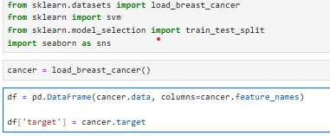
Breast Cancer Dataset
This is dataset containing the data of tumour
The target columns tells us if the tumour is malignant or benign

Slide 6
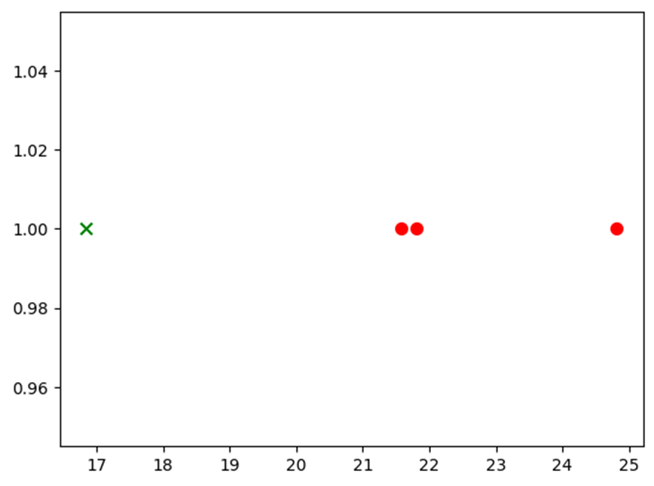
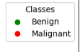

1 D Plot of Mean Radius and Introduction of SVM
Mean Radius

Slide 7
1 D Plot of Mean Radius
Mean Radius
Putting a Threshold

Slide 8
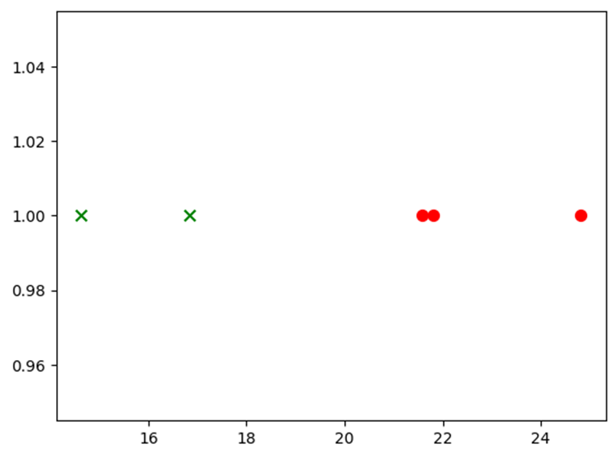
SVM How it looks
Mean Radius
If any new point is added to it ?

Slide 9

SVM How it looks
Margin
Mean Radius
They help is determining the optimum threshold line in the plot.
They are one of the principal component for SVM classification
Support Vectors
In a 1D Figure

Slide 10
SVM How it looks
Lets see how it looks like in 2D !

Slide 11
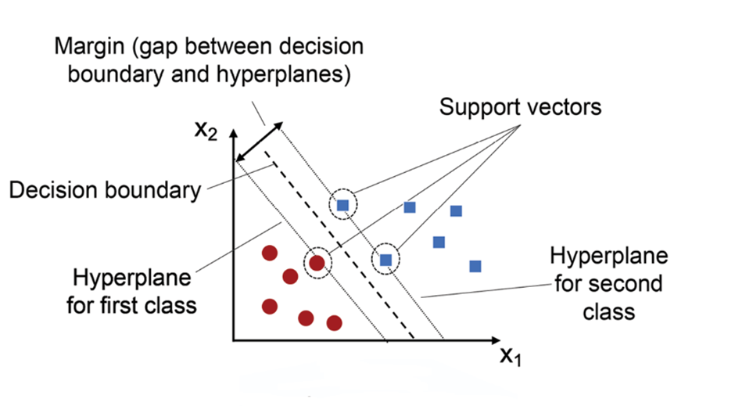
SVM How it looks
In a 2D Figure , we have a 1D line (The threshold Line we defined before)
For a D dimensional Figure we have a D-1 Dimensional Plane

Slide 12
SVM How it looks
I have added a new feature to it called mean texture .

Slide 13
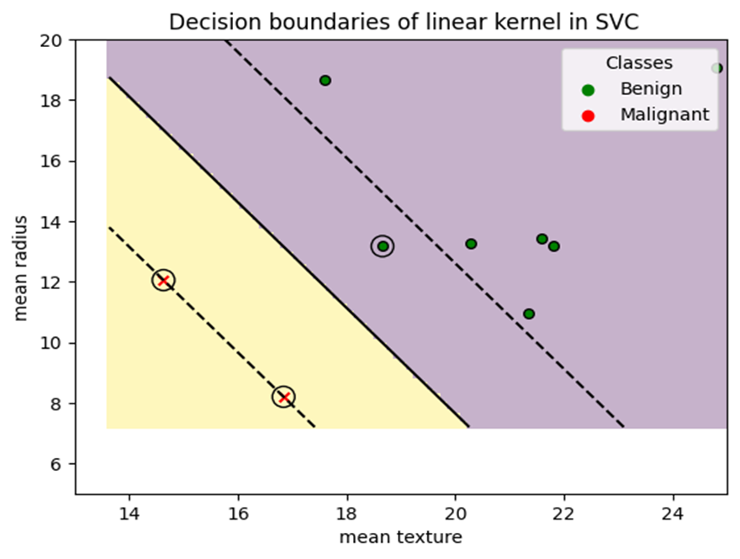

SVM How it looks

Slide 14
SVM How it looks
Lets continue with 1 D Plot ….

Slide 15



Maximum Margin Classifier
Mean Radius
As the distance of the threshold is same in both direction so we are getting the maximum margin to make classification we are getting Maximum Margin Classifier
It is also known as Hard Margin Classifier
In this we assume that the point are linearly separable

Slide 16
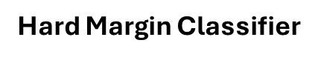
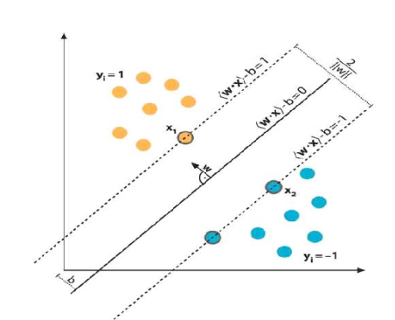
So how does it look like in 2D?
What are theses parameters?
W -> Normal to the plane
X -> The datapoint
B -> The intercept value(bias Value)

Slide 17
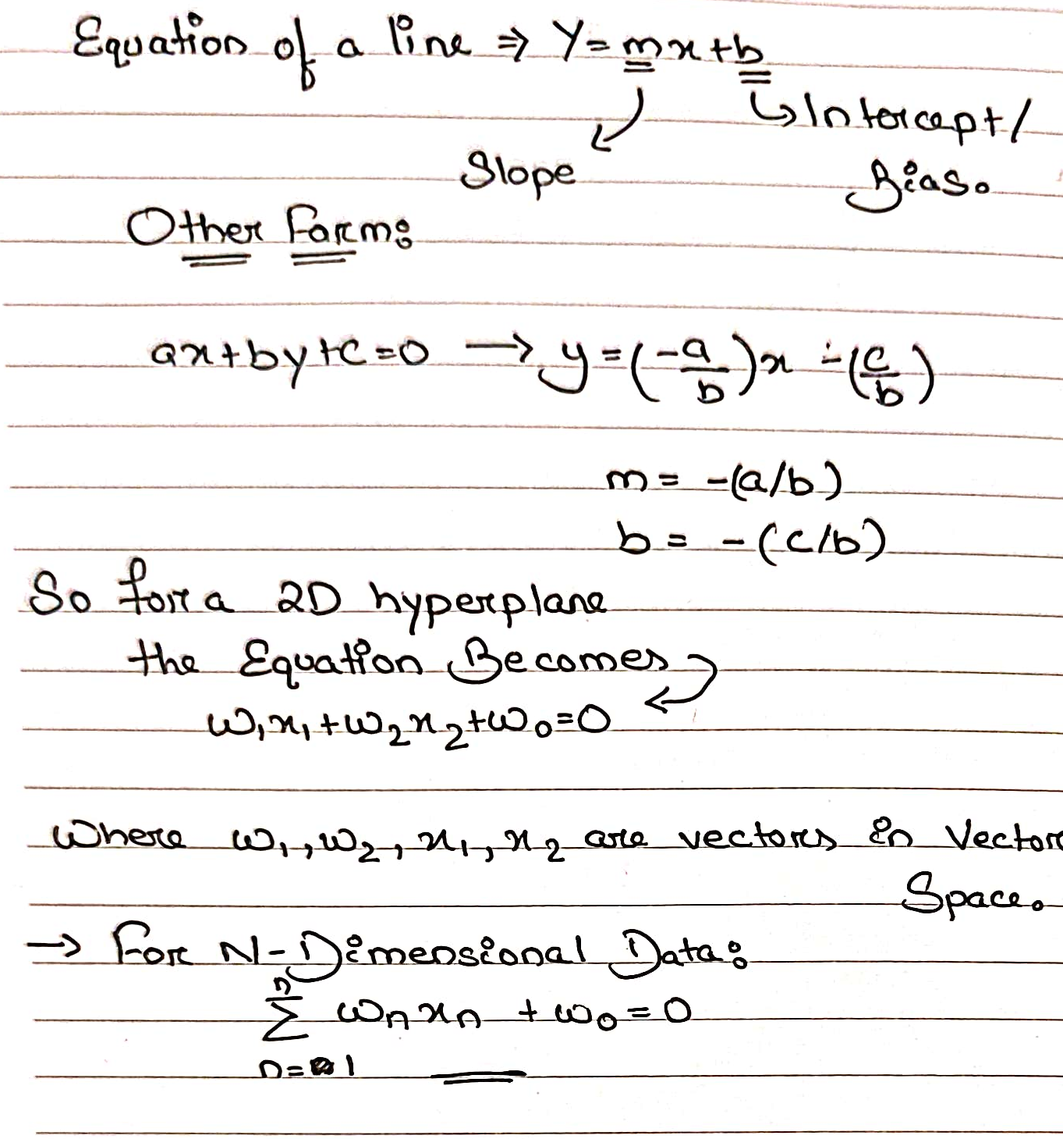
The maths behind it !

Slide 18
The maths behind it !

Slide 19
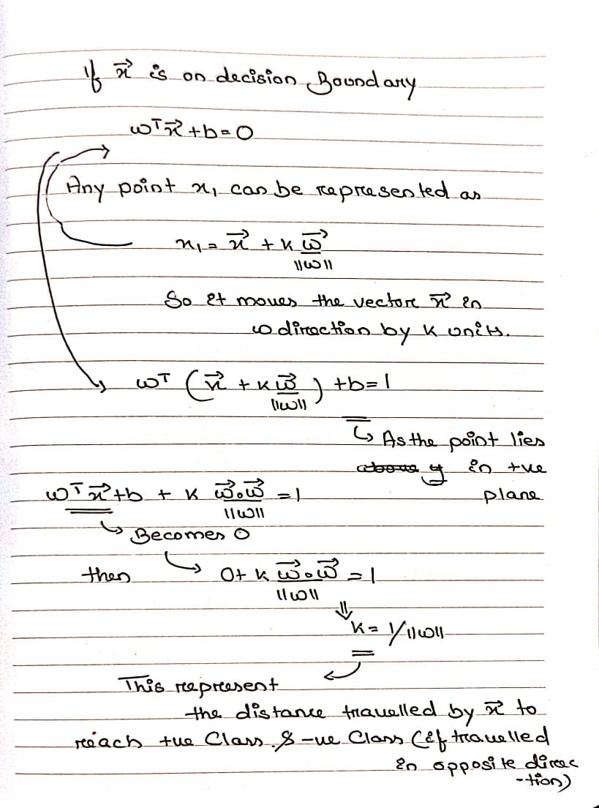

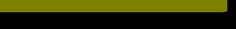
The maths behind it !

Slide 20
The maths behind it !
Decision rules:
for y=+1 -> W^T*X+b≥1
for y=-1 -> W^T*X+b≤-1
Y*(W^T*X+b)≥+1

Slide 21
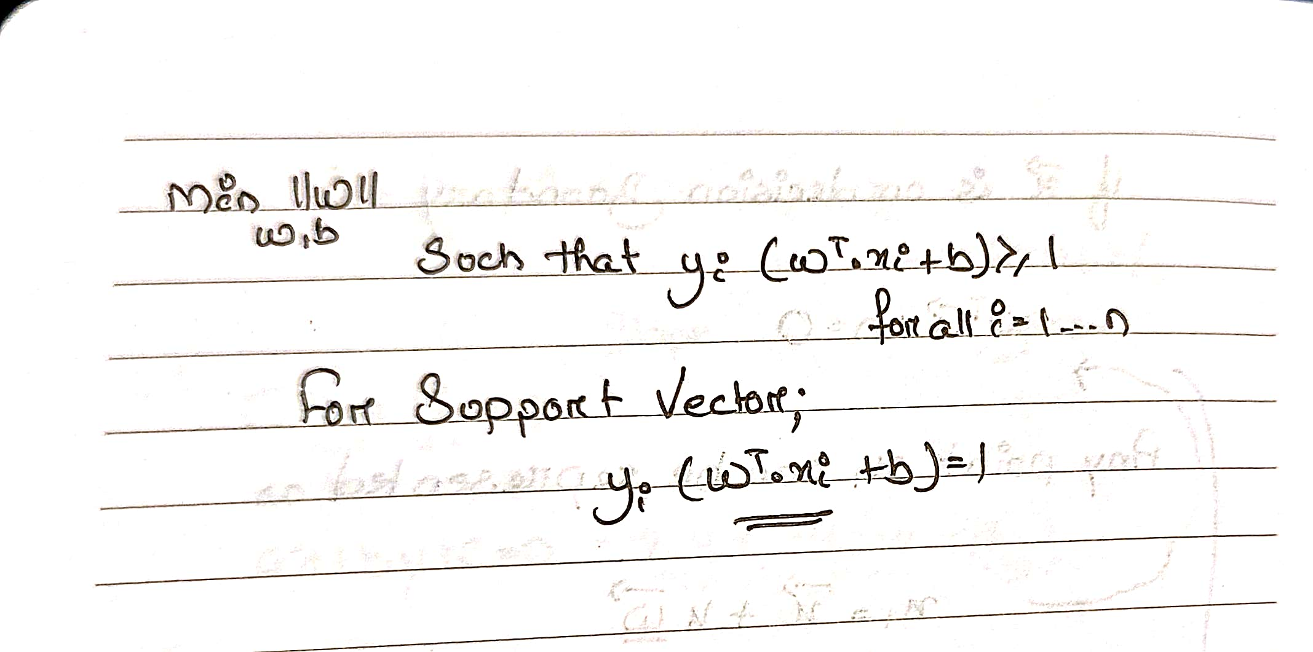
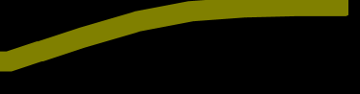
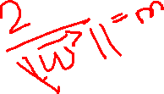

Main Aim:
The maths behind it !

Slide 22
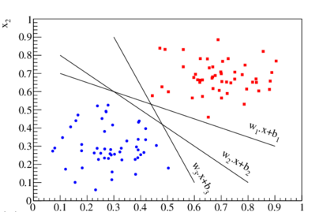
Choosing a Hard margin!
So there are many lines in this 2D plane which one to choose?

Slide 23
Choosing a Hard margin!
The Answer : The one which is farthest from the data points or the one which has a maximum margin

Slide 24
There’s no such thing as perfect!
Soft Margin Classifier !!
Mean Radius

Slide 25
Soft Margin Classifier !!
Mean Radius

Slide 26
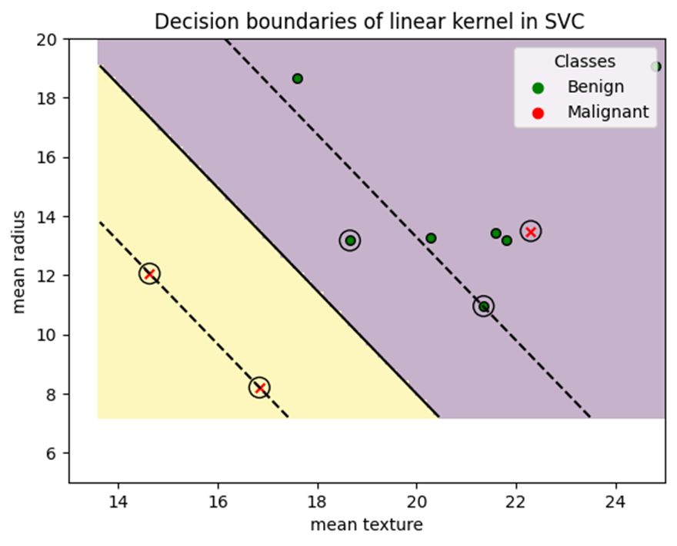
Soft Margin Classifier :
In it error are introduced willingly to have a wider and a generalized margin
Slack variables and a regularization parameter (C) to control the trade-off between margin and misclassification
The use of the C parameter is a trade-off between having a large margin and correctly classifying the training data
Here we can visualize how variation of C affects the classification: Link

Slide 27

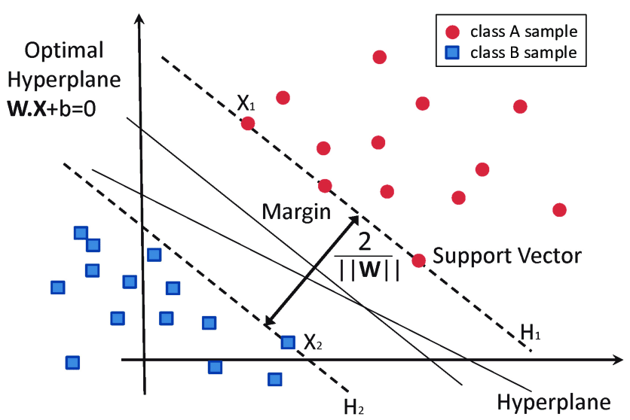
The maths behind it !

Slide 28
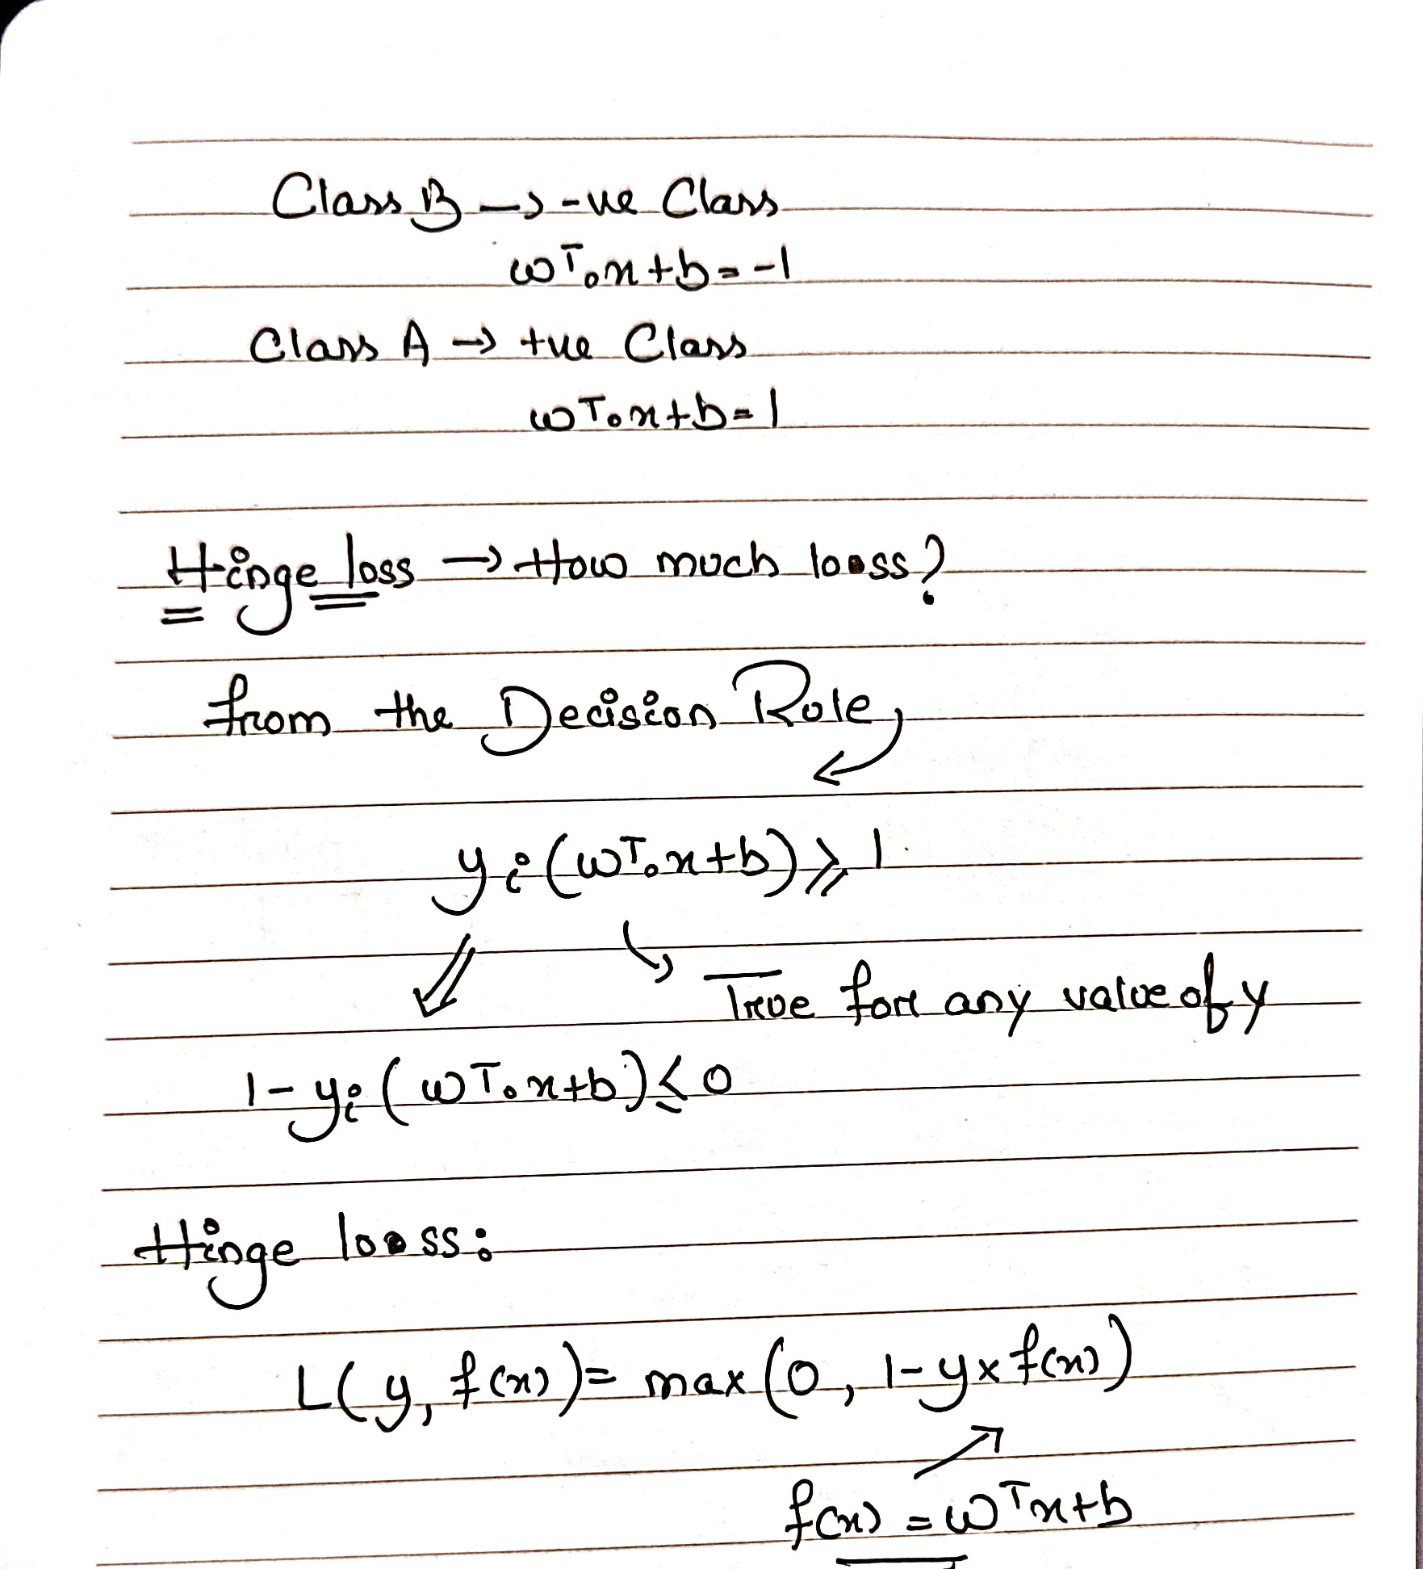

The maths behind it !

Slide 29
The maths behind it !
Hinge loss function:
This hinge loss function tells about how much loss or error has been incurred for each data point. For correctly classified data points the hinge loss will always be zero and for misclassified points, the error will be greater than zero.
Let’s apply that hinge loss to those data points and see what the output looks like.
For a correctly classified data point that lies in the positive class [ y=1 ]:- max(0,1-y*f(x)) = max(0,1–1*(>=1)) = 0.
For a correctly classified data point that lies in the negative class [y=-1]:- max(0,1-y*f(x)) = max(0,1-(-1)*(<=-1)) = max(0,1*(<=-1)) = 0
For a negative data point that lies in the positive class [ y = -1]:- max(0,1-y*f(x)) = max(0,1-(-1)*(>1)) = max(0,>1) = >1
For a negative data point that is correctly classified but it’s inside the margin [y=-1]:- max(0,1-(-1)*([-1 to 0])) = max(0,[-1 to 0]) = [-1 to 0]

Slide 30
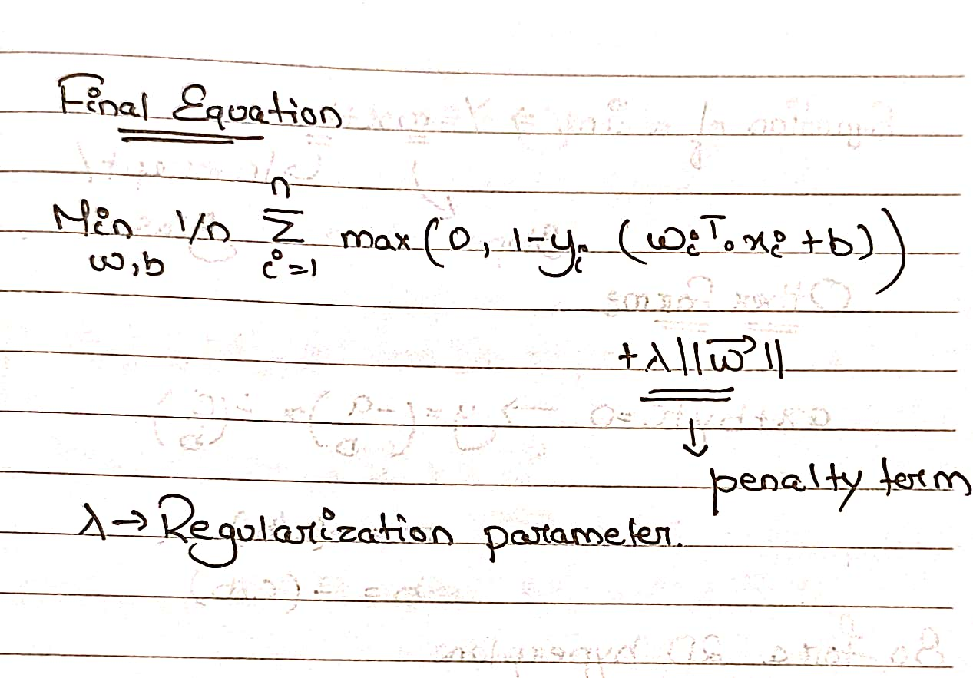
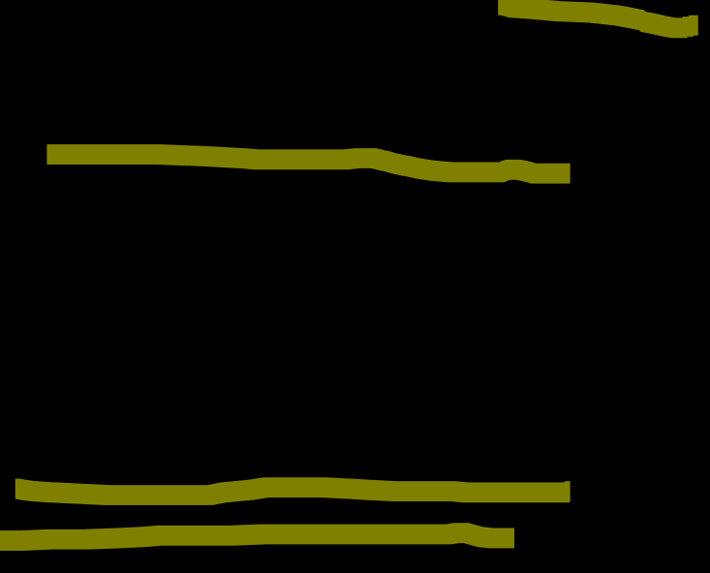
The maths behind it !
Main Aim of Soft Margin:
Minimizing the misclassification error
Increasing the size of the margin.

Slide 31
The maths behind it !
Decision rules:
for y=+1 -> W^T*X+b≥1
for y=-1 -> W^T*X+b≤-1
Y*(W^T*X+b)≥+1

Slide 32
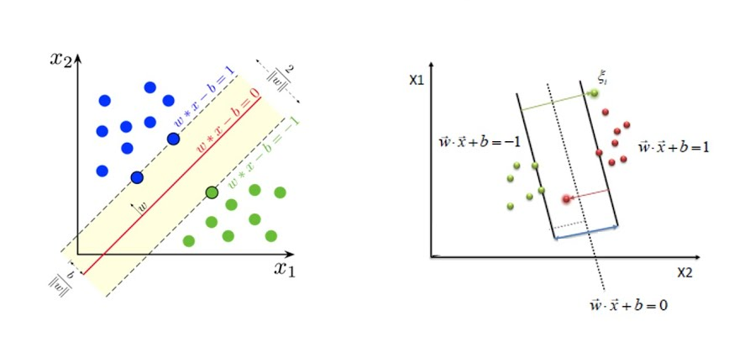
Soft Margin Classifier VS Hard Margin Classifier
Hard Margin SVM: In a hard margin SVM, we assume that our data is linearly separable without any errors. The goal is to find a hyperplane that perfectly separates the classes, with no data points falling within the margin boundaries. This approach aims for maximum separation and can be seen as an "all-or-nothing" strategy. While hard margin SVMs provide excellent accuracy when the data is indeed linearly separable, they are highly sensitive to outliers or noisy data points. Even a single misclassified point can significantly impact the model's performance and lead to overfitting.
Soft Margin SVM: It allows misclassification by allowing data points to fall within the margin boundaries or even on the wrong side of the hyperplane. The objective becomes finding a balance between maximizing separation and minimizing misclassification errors. Soft margin SVMs employ a regularization parameter (C) that controls the trade-off between achieving a wider margin and tolerating misclassifications. A higher C value emphasizes correct classification, resulting in narrower margins but potentially more accurate predictions. Conversely, a lower C value prioritizes wider margins at the expense of potential misclassifications.

Slide 33

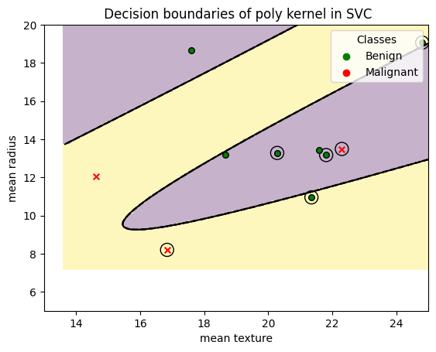
Different types of SVMs:
There are 2 types of SVMs:
Linear SVM
Non – Linear SVM

Slide 34
Linear SVM
These type of classifier are best for data which are linearly separable.
As it is a 2-dimensional space, we can easily separate these two classes by using a straight line. But there can be multiple lines that can separate these classes.

Slide 35
Linear SVM
These type of classifier are best for data which are linearly separable.
As it is a 2-dimensional space, we can easily separate these two classes by using a straight line. But there can be multiple lines that can separate these classes.
The distance between the support vectors(Here in the figure the one with circle around them) and the hyperplane is called as margin. And the goal of SVM is to maximize this margin
So, the decision boundary (which is line in this figure) is chosen with above applied constrain.

Slide 36
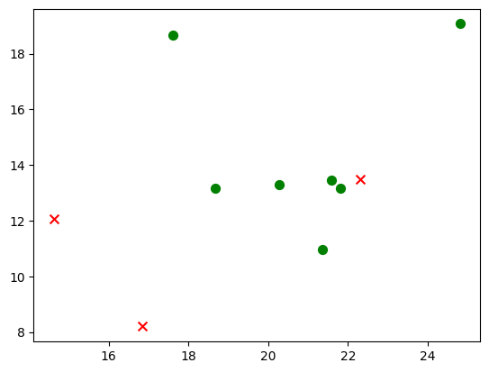
Non - Linear SVM
What if the data is not linearly separable?

Slide 37

Non - Linear SVM
What if we try to fit a linear decision boundary in it?

Slide 38
Non - Linear SVM
So here we get that some points are being misclassified . Lets take more points to plot!

Slide 39
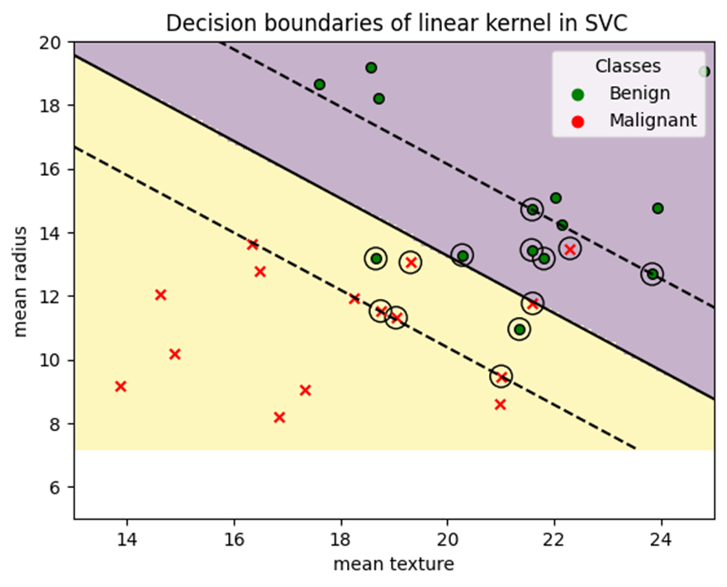
Non - Linear SVM
Here we can see that the line is not a good fit . The decision boundary is misclassifying many points .

Slide 40
Non - Linear SVM
So what to do ?

Slide 41
Non - Linear SVM
We can add a new feature as a new dimension or add a feature that is a combination of existing features

Slide 42
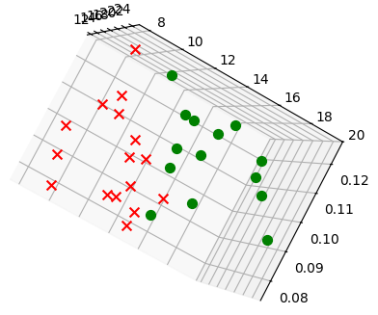
Non - Linear SVM
Here if we add a new feature to it : Mean smoothness

Slide 43
Non - Linear SVM
The Problem with this method:
The calculation load .
As we see the hyperplane we are seeing is just a 2d plane which is also misclassifying some points .
So to find the perfect plane we would need to take each point in the dataset as a reference each time and find the distance of all other points with respect to that point.
n*(n-1)/2 distances would be calculated
The time complexity of a square root is O(log(n)) and for power, addition is O(1). Thus to do n*(n-1)/2 total calculations we would need O(n²log(n)) time complexity.

Slide 44
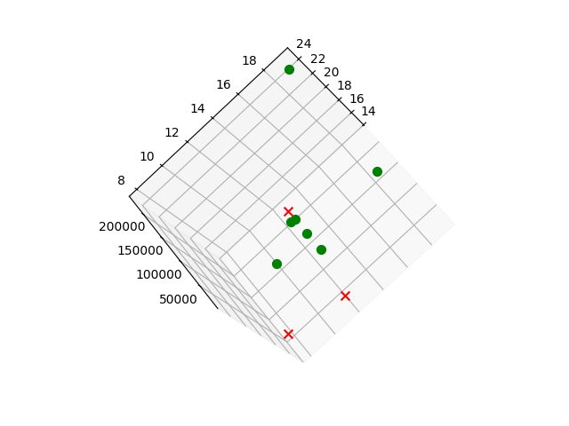
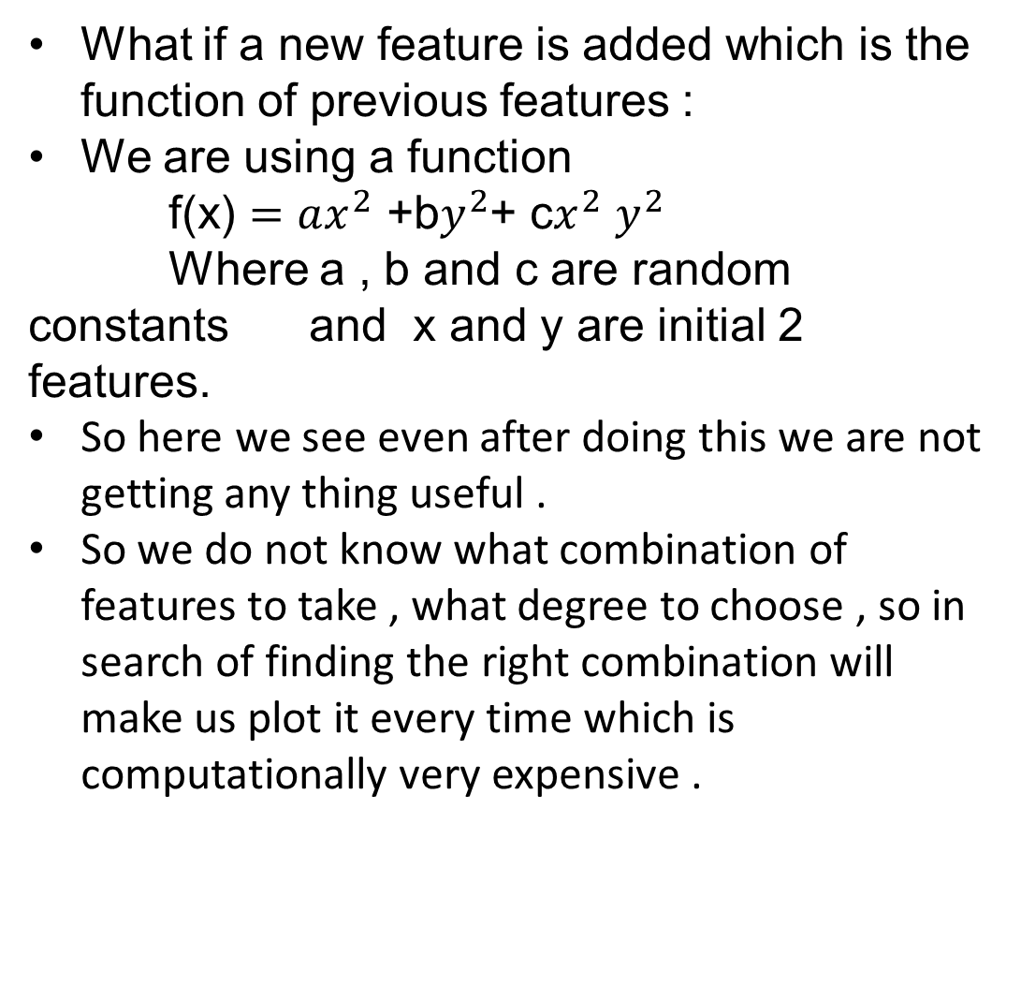
Non - Linear SVM
What if a new feature is added which is the function of previous features :
We are using a function
f(x) $=ax^{2}$ +b$y^{2}$+ c$x^{2}$ $y^{2}$
Where a , b and c are random constants and x and y are initial 2 features.
So here we see even after doing this we are not getting any thing useful .
So we do not know what combination of features to take , what degree to choose , so in search of finding the right combination will make us plot it every time which is computationally very expensive .

Slide 45
Non - Linear SVM
Any Solution?????

Slide 46
Non - Linear SVM
Mathematics Here for Rescue!!

Slide 47
Non - Linear SVM
Kernel Trick

Slide 48
Non - Linear SVM
Kernel Trick A Kernel Trick instead of adding another dimension/feature, finds the similarity of the points.
Instead of finding f(x,y) directly, it computes the similarity of the image of these points. In other words, instead of finding f(x1,y1) and f(x2,y2) we take the points (x1,y1) and (x2,y2) and compute how similar would their outputs be using a function f(x,y); where f can be any function on x,y.
Thus we don’t need to find a suitable set of features here. We find similarity in such a way that it is valid for all sets of features.
To calculate the similarity we use the Gaussian function.
f(x) = ae^(-(x-b)²/2c²)
a : represents the height of the peak of the curve
b : represents the position of the centre of the peak
c : is the standard deviation of the data

Slide 49
Kernel Trick
For example:
x = (x1, x2); y = (y1, y2). Then for the function f(x) = (x1x1, x1x2, x2x1, x2x2), the kernel is K(x, y ) = (<x, y>)^2
So if x = (1, 2) ; y = (1, 2) f(x) = (1,2,2,4)
f(y) = (1,2,2,4)
<f(x), f(y)> = 1+4+4+16 = 25
So here a lot of algebra for mapping f from 2 D to 4 D.
So if we try to use the Kernel then :
K(x,y) = (1+4) ^2
= 25
The same intuition can be done for a data to map it from a lower dimension to a higher dimension (may be infinite!!!) Why it can also be understood as a measure of similarity: if we put the definition of kernel above, <f(x), f(y)>, in the context of SVM and feature vectors, it becomes <phi(x), phi(y)>. The inner product means the projection of phi(x) onto phi(y). or colloquially, how much overlap do x and y have in their feature space. In other words, how similar they are.
Lets Understand it a little more …

Slide 50
Kernel Trick
For RBF Kernel we use:
K(X,X’) = e^-γ(|X-X’|²) = (1/ e^|X-X’|²) γ
Time Complexity
Since we need to find the similarity of each point with respect to all other points we need a total of n*(n-1)/2 calculations.
Exponent has a time complexity of O(1) and thus we get a total time complexity of O(n²).

Slide 51
Types of Kernels
We have Kernels such as:
Linear Kernel
Polynomial Kernel
Gaussian Kernel
Gaussian RBF Kernel
Laplace RBF Kernel
Hyperbolic Tangent Kernel
Sigmoid Kernel
Bessel function of first kind Kernel
ANOVA radial basis Kernel
Linear Splines Kernel

Slide 52
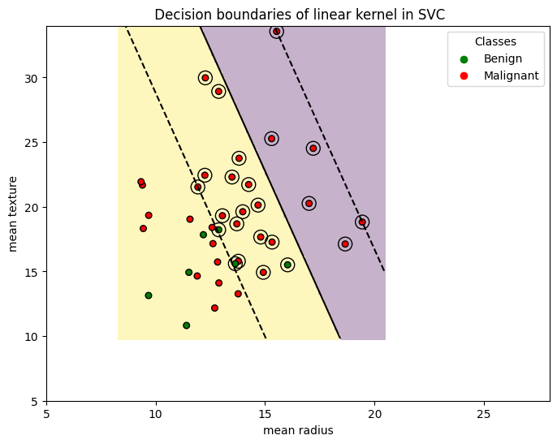
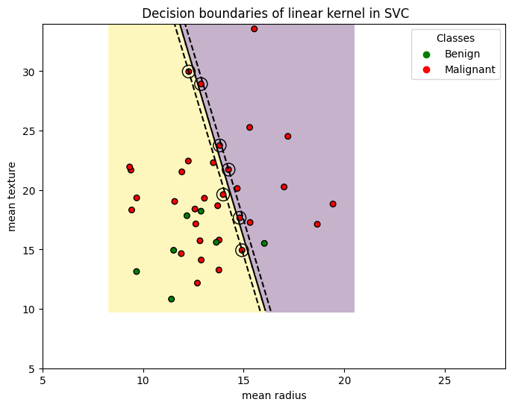
Linear Kernel
Basically, a Straight line or a hyperplane in higher dimension
It is represented as: K(x,y)=x.y
It is used for text classification problems such as spam detection
Below the image in left shows C = 0.01 and in right shows C = 100

Slide 53
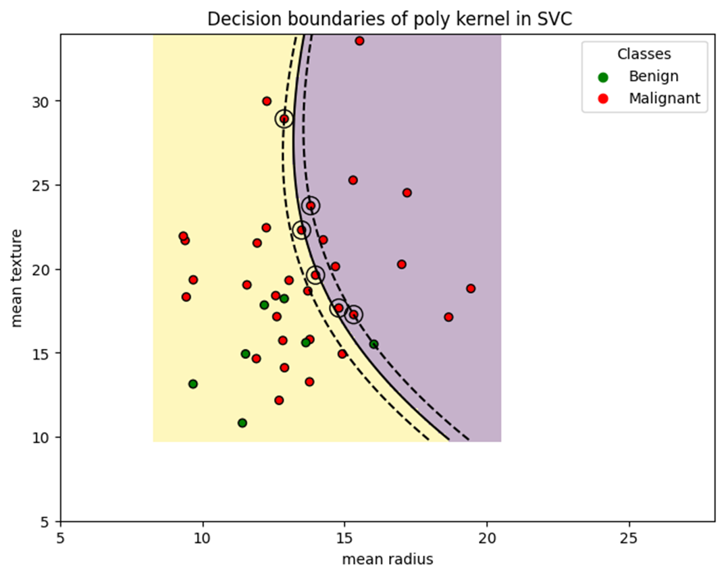
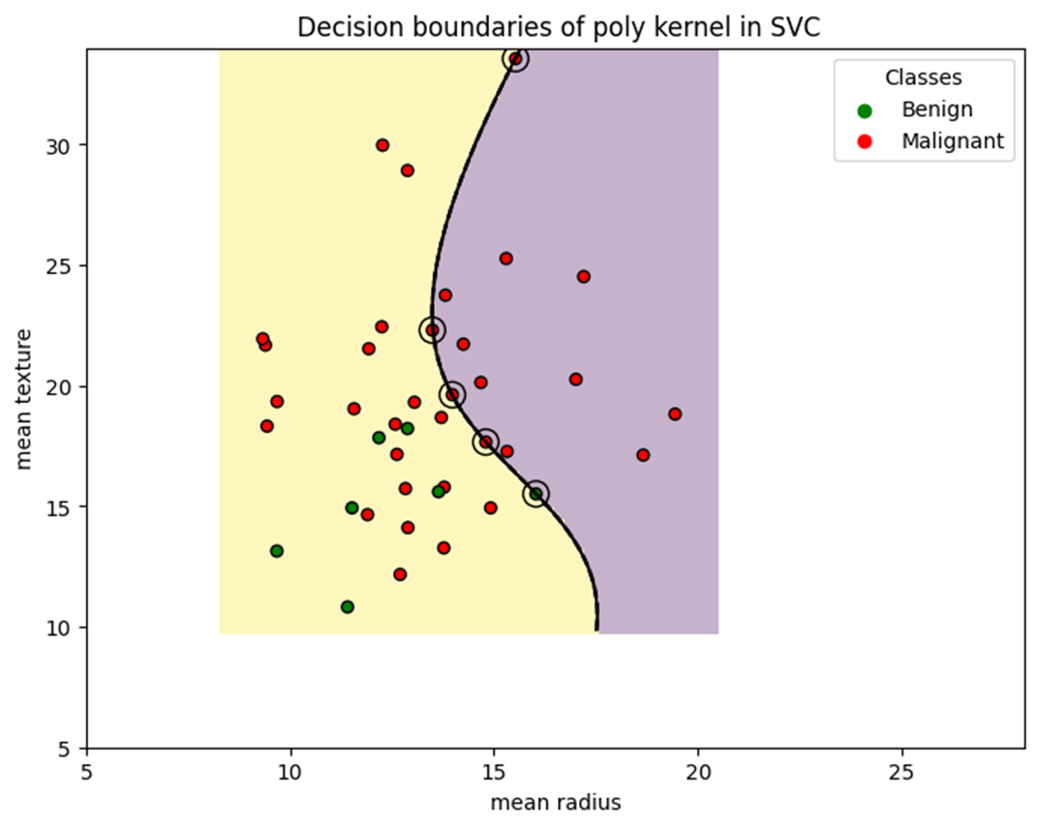
Polynomial Kernel
Basically, the decision boundary is complex in nature as the datapoints are non linear in nature
It is represented as: K(x,y)=(x.y+c) **d(d is degree of polynomial )
The value of d is 3 by default in sklearn
It is used for image recognition or wherever he relationship is non linear
Below the image in left shows C = 000001 and in right shows C = 100

Slide 54
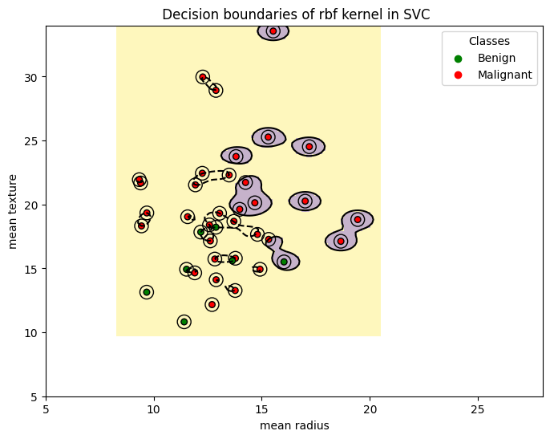
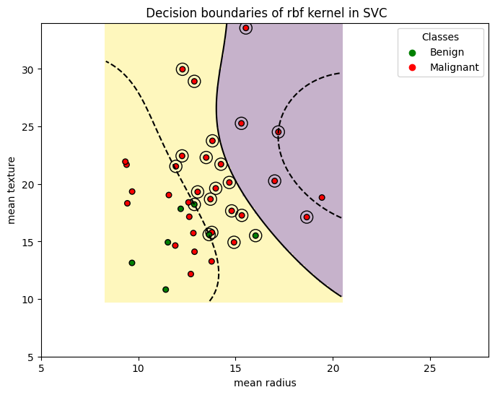
RBF Kernel
Formula: K(x, y) = exp(-γ ||x — y||²)
It has a parameter called Gamma γ.
γ : is a hyperparameter which represents the linearlity of the model (γ ∝ 1/c²)
X,X’ :represents the position vectors of the two points
A small γ (tending to 0) means a more linear model and a large γ means a more non-linear model.
So γ defines the strength of a support vector , how much can it curve the decision line .
Here we have 2 models (left with γ = 1.5 and right with γ = 0.01, much more linear in nature).

Slide 55
So many kernels which one to use ????
To Say it frankly its up to you to decide !!
But there is a way to compare different values of gamma and C hyperparameter and kernel types by use of Grid Search!!

Slide 56
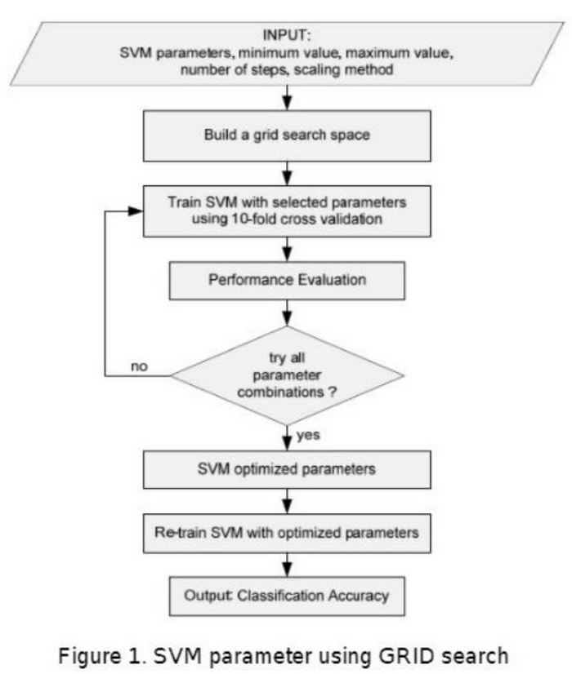
Grid Search
Grid Search is an optimization method to find the best parameters for the SVM model.
It systematically evaluates the combination of hyperparameters, such as C and gamma, and selects the best-performing combination based on cross-validation

Slide 57
A thing we missed !
How to avoid Overfitting!!!

Slide 58
Overfitting
To avoid overfitting in Support Vector Machines (SVM), you can implement several strategies:
Regularization (C parameter): In SVM, the hyperparameter "C" controls the trade-off between maximizing the margin and minimizing the classification error on the training data. A smaller "C" value introduces a larger margin but may allow some training points to be misclassified. Experiment with different "C" values to find the right balance for your dataset. Larger values of "C" can lead to overfitting, so consider reducing it.
Feature selection and engineering: Carefully select and preprocess your features. Remove irrelevant or redundant features that don't contribute to the model's performance and can lead to overfitting. Feature scaling and normalization can also help SVM perform better and be less prone to overfitting.
Cross-validation: Use techniques like k-fold cross-validation to assess the model's performance on different subsets of the data. This helps you evaluate how well the model generalizes to unseen data and can highlight overfitting issues.
Kernel selection: Be cautious when choosing the kernel function for your SVM. Complex kernels, like radial basis function (RBF), can be prone to overfitting, especially when data is limited. Experiment with simpler kernels and fine-tune hyperparameters to find the right balance between model complexity and generalization.

Slide 59
Advantages of SVM
Advantages:
High Accuracy: SVM offers excellent accuracy and performs well with high-dimensional data.
Memory Efficient: It uses a subset of training points, which reduces memory consumption.

Slide 60
Advantages of SVM
Advantages:
High Accuracy: SVM offers excellent accuracy and performs well with high-dimensional data.
Memory Efficient: It uses a subset of training points, which reduces memory consumption.

Slide 61
References
Anon., 2025. [Online] Available at: https://www.worldscientific.com/doi/10.1142/S0129065724500047?srsltid=AfmBOoo_zWp37OOslGIIilEk-9U9C9KSgi-ifJCeJKavAefNma9VwcQ8
Anon., 2025. [Online] Available at: https://www.analyticsvidhya.com/blog/2021/10/support-vector-machinessvm-a-complete-guide-for-beginners/
Anon., 2025. [Online] Available at: https://www.youtube.com/watch?v=efR1C6CvhmE&t=563s
Anon., 2025. [Online] Available at: https://www.quora.com/What-are-kernels-in-machine-learning-and-SVM-and-why-do-we-need-them
Anon., 2025. [Online] Available at: https://medium.com/@sachinsoni600517/unlocking-the-ideas-behind-of-svm-support-vector-machine-1db47b025376#:~:text=Mathematically%2C%20for%20each%20data%20point,of%20the%20data%20point%20xi.&text=%CE%BEi%20%3D%200%20if%20xi%20is,correct%20side%20of%20the%
Anon., 2025. [Online] Available at: https://www.youtube.com/watch?v=8HdUVE5fjUE
Anon., 2025. [Online] Available at: https://scikit-learn.org/stable/modules/generated/sklearn.inspection.DecisionBoundaryDisplay.html
Anon., 2025. [Online] Available at: https://www.sciencedirect.com/topics/engineering/linear-support-vector-machine#:~:text=Linear%20SVM%3A%20Linear%20SVM%20is,as%20a%20Linear%20SVM%20classifier.
Anon., 2025. [Online] Available at: https://www.geeksforgeeks.org/ml-non-linear-svm/
Anon., 2025. [Online] Available at: https://medium.com/@abhishekjainindore24/svm-kernels-and-its-type-dfc3d5f2dcd8
Anon., 2025. customer-segmentation-using-rfm-analysis-and-k-means-clustering-in-python. [Online] Available at: https://medium.com/@omotolaniosems/customer-segmentation-using-rfm-analysis-and-k-means-clustering-in-python-d9d90fc24e18
Anon., 2025. support-vector-machines-svm-an-intuitive-explanation. [Online] Available at: https://medium.com/low-code-for-advanced-data-science/support-vector-machines-svm-an-intuitive-explanation-b084d6238106
RobuRishabh, 2025. support-vector-machines. [Online] Available at: https://medium.com/@RobuRishabh/support-vector-machines-svm-27cd45b74fbb
Anon., 2025. [Online] Available at: https://en.wikipedia.org/wiki/Support_vector_machine

